Slide 1


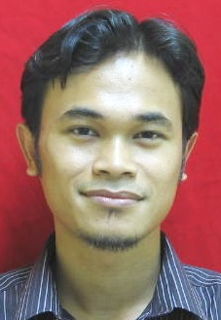


7
Final Year
Project
< 2019 >
Dr. Mohd Hanif Bin Mohd Ramli
(Supervisor)
Mohamad Haziq Bin Ahmad Yusri
(2015218614)
Learning Never End
Mechanical Engineering
(Semester 8)

Slide 2
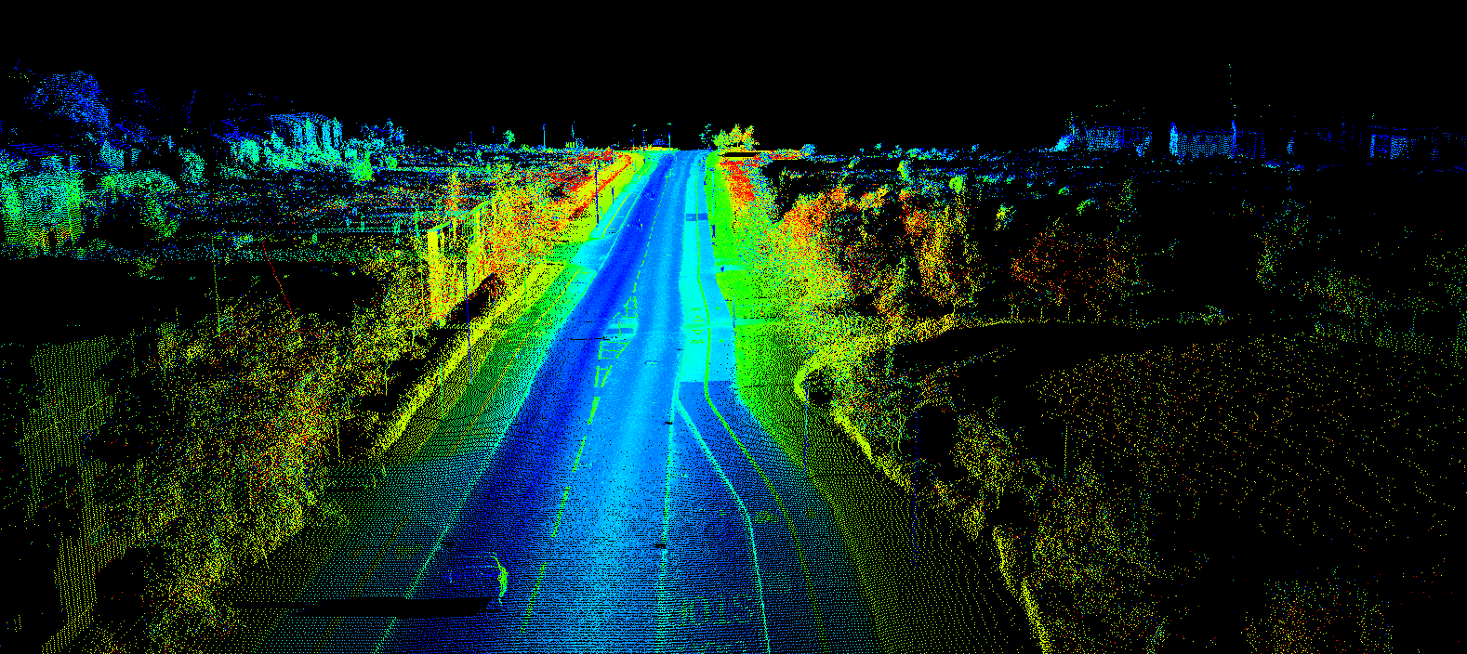
Autonomous navigation
Deployment on an unmanned ground vehicle

Slide 3
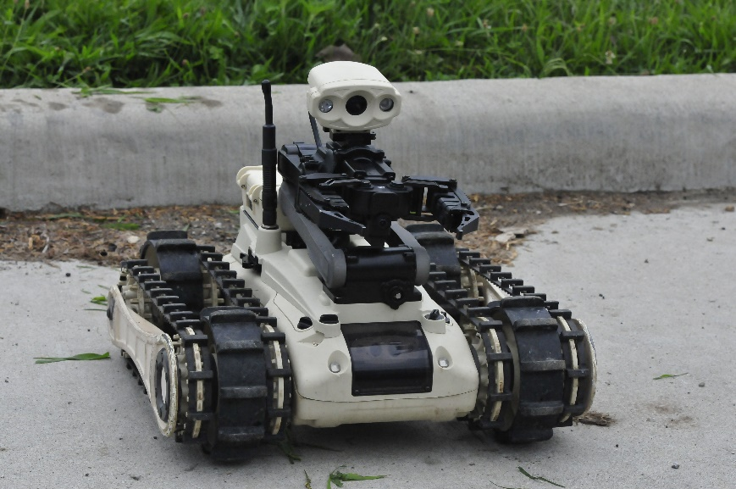

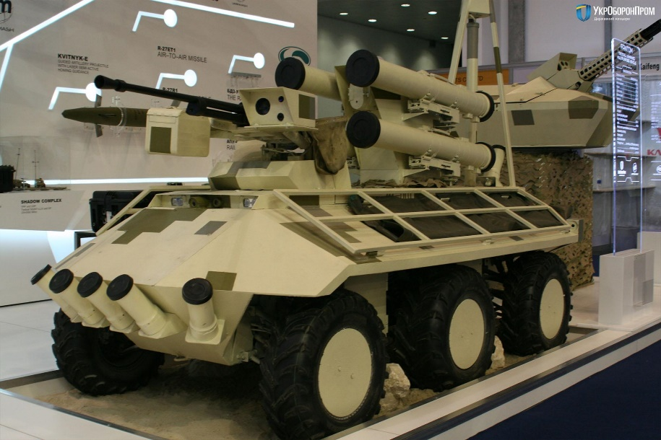
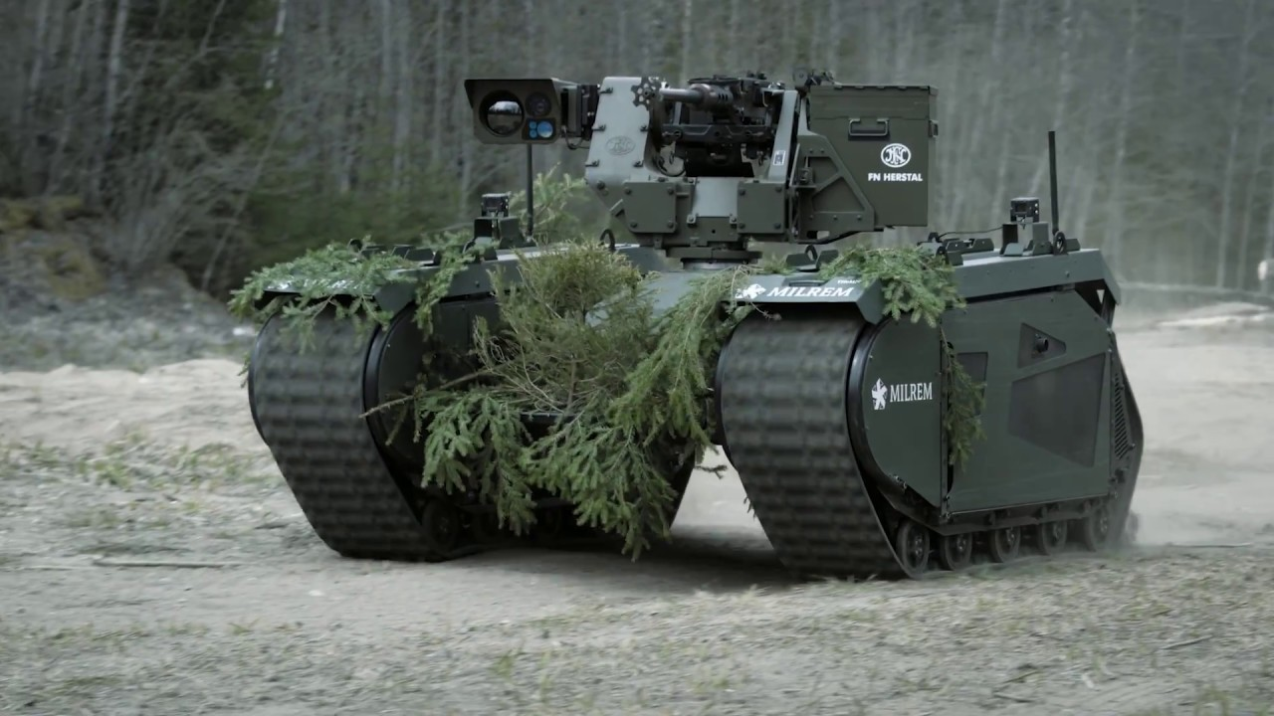
What is UGV?
FINAL YEAR PROJECT
AUTONOMOUS vehicle
UGV is an Unmanned
Ground Vehicle where usually
used in military section

Slide 4
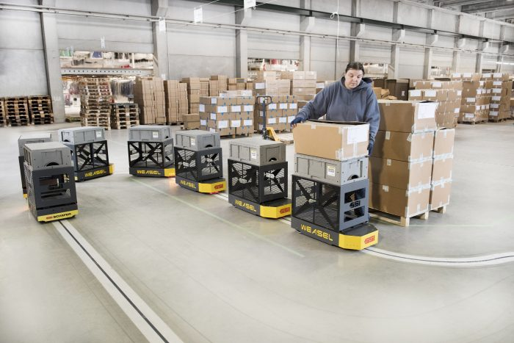
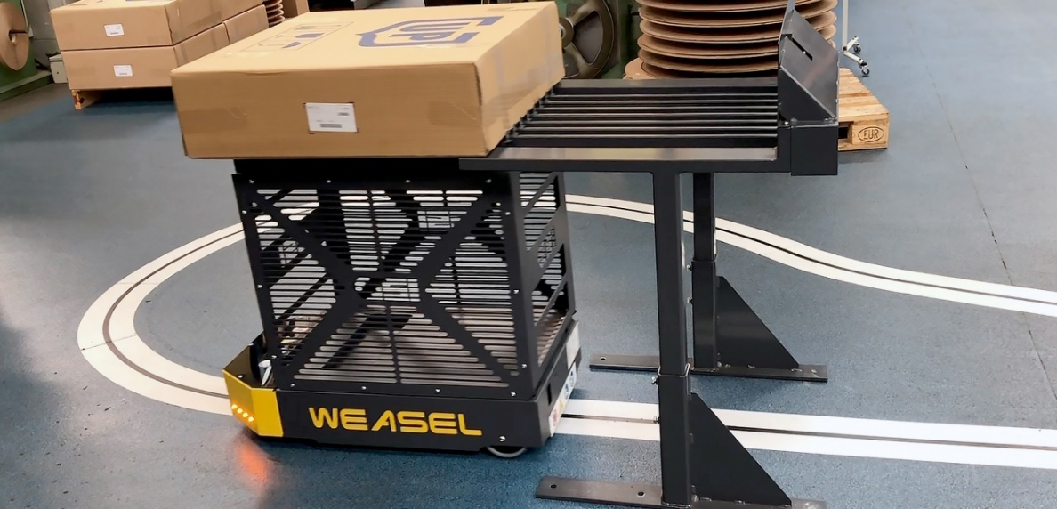
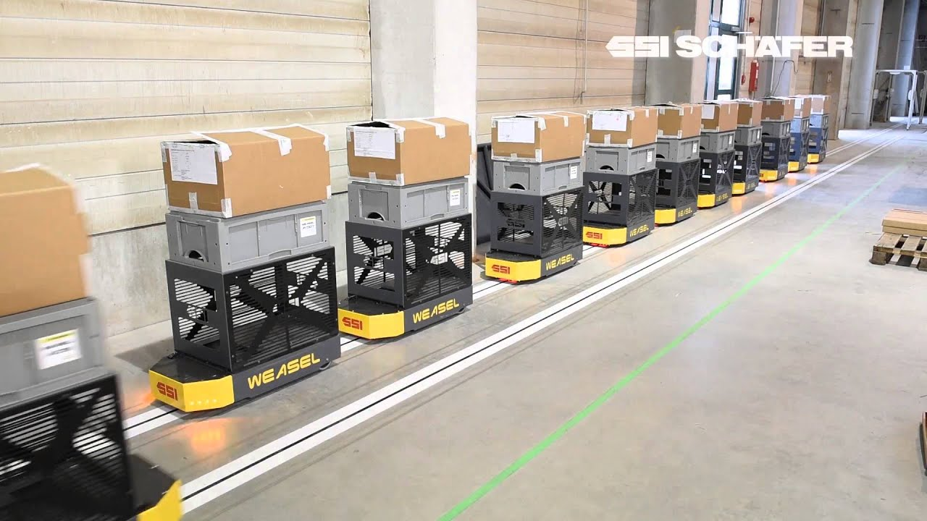
What is AGV?
FINAL YEAR PROJECT
AUTONOMOUS vehicle
AGV is an Automated
Guided Vehicle where usually
used in industry site

Slide 5
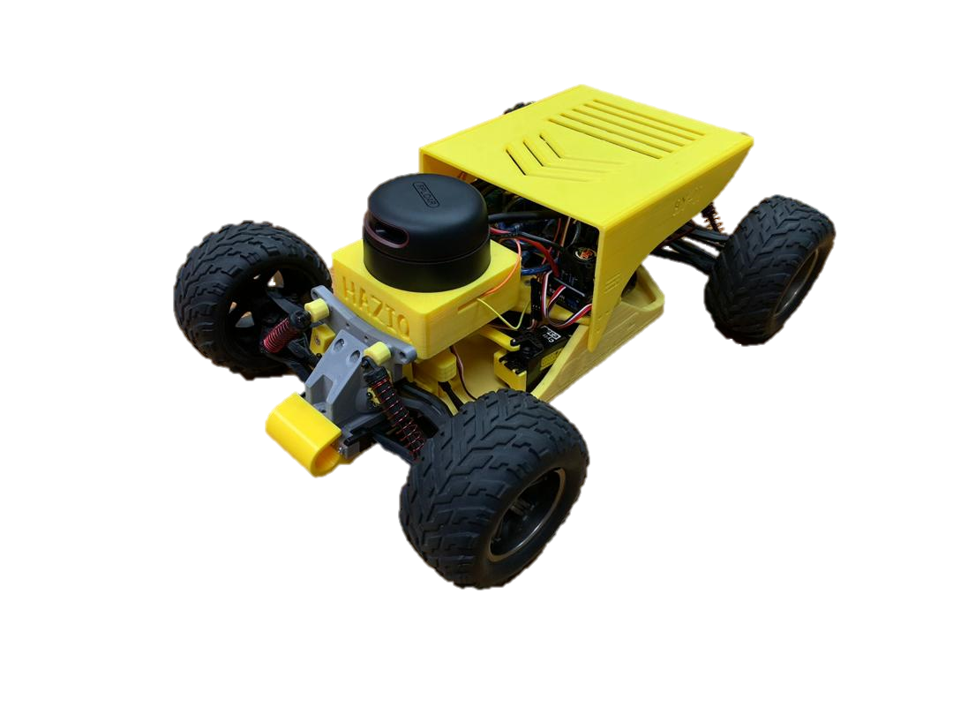


FYP PROJECT
UGV based concept apply at industrial site by replacing line tracking sensor.

Slide 6

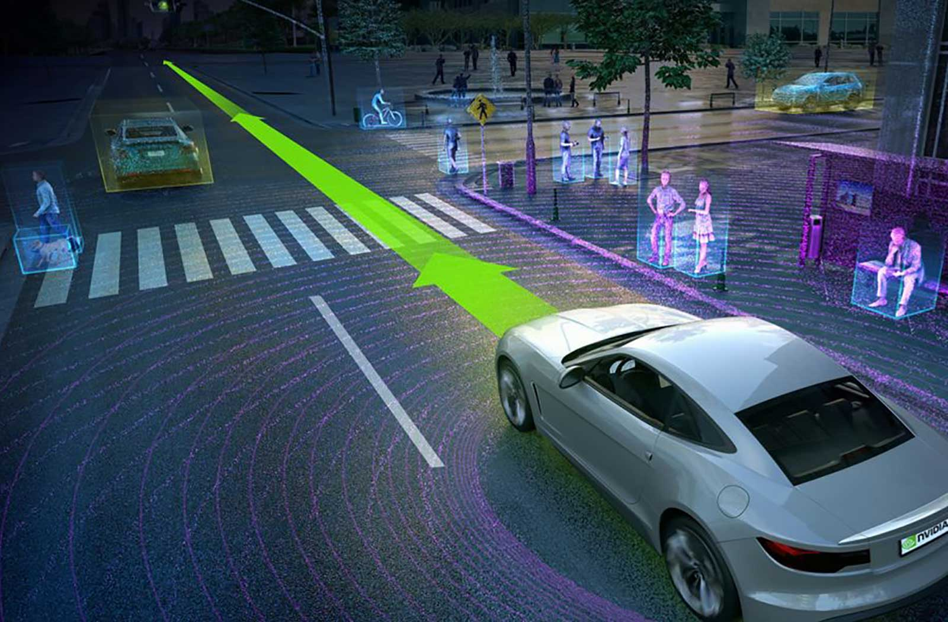
LIDAR SENSOR CAPABILITIES

Slide 7
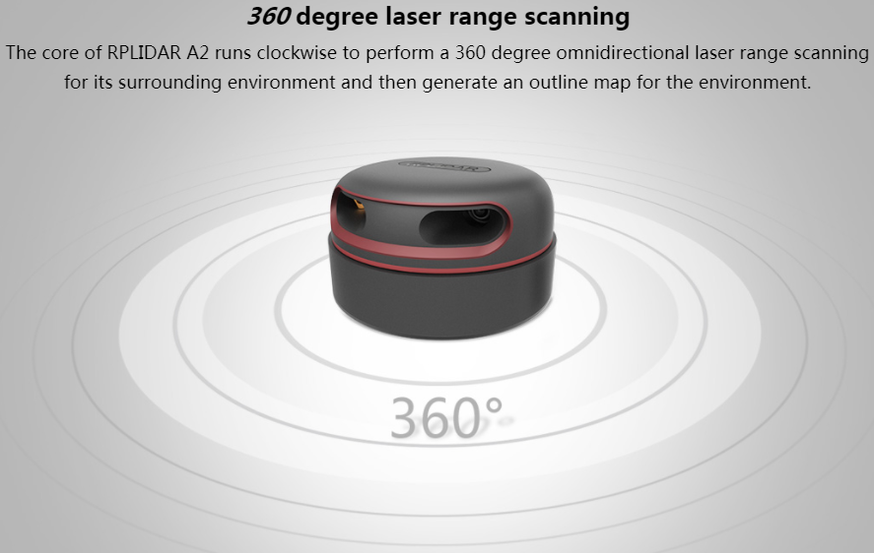
LIDAR SENSOR CAPABILITIES

Slide 8
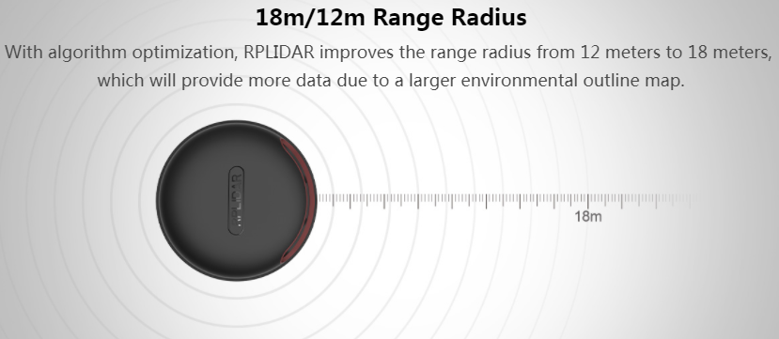
LIDAR SENSOR CAPABILITIES

Slide 9
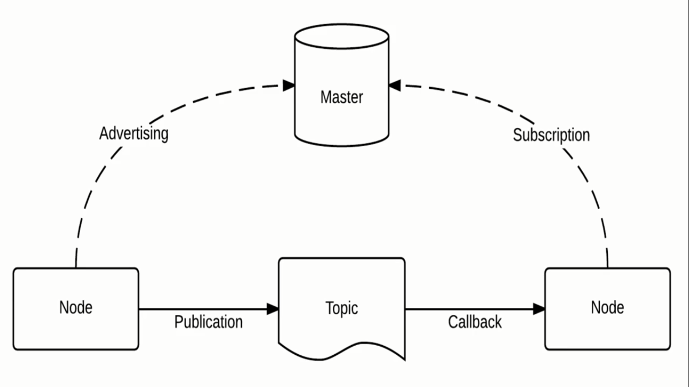
Robot Operating System (ROS)
ROS environment

Slide 10
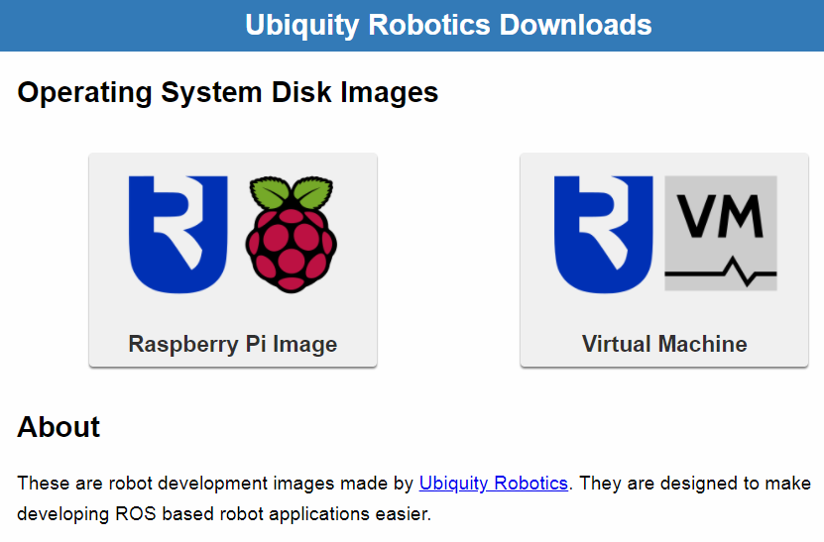
Image installation for the UGV
SD card installment

Slide 11
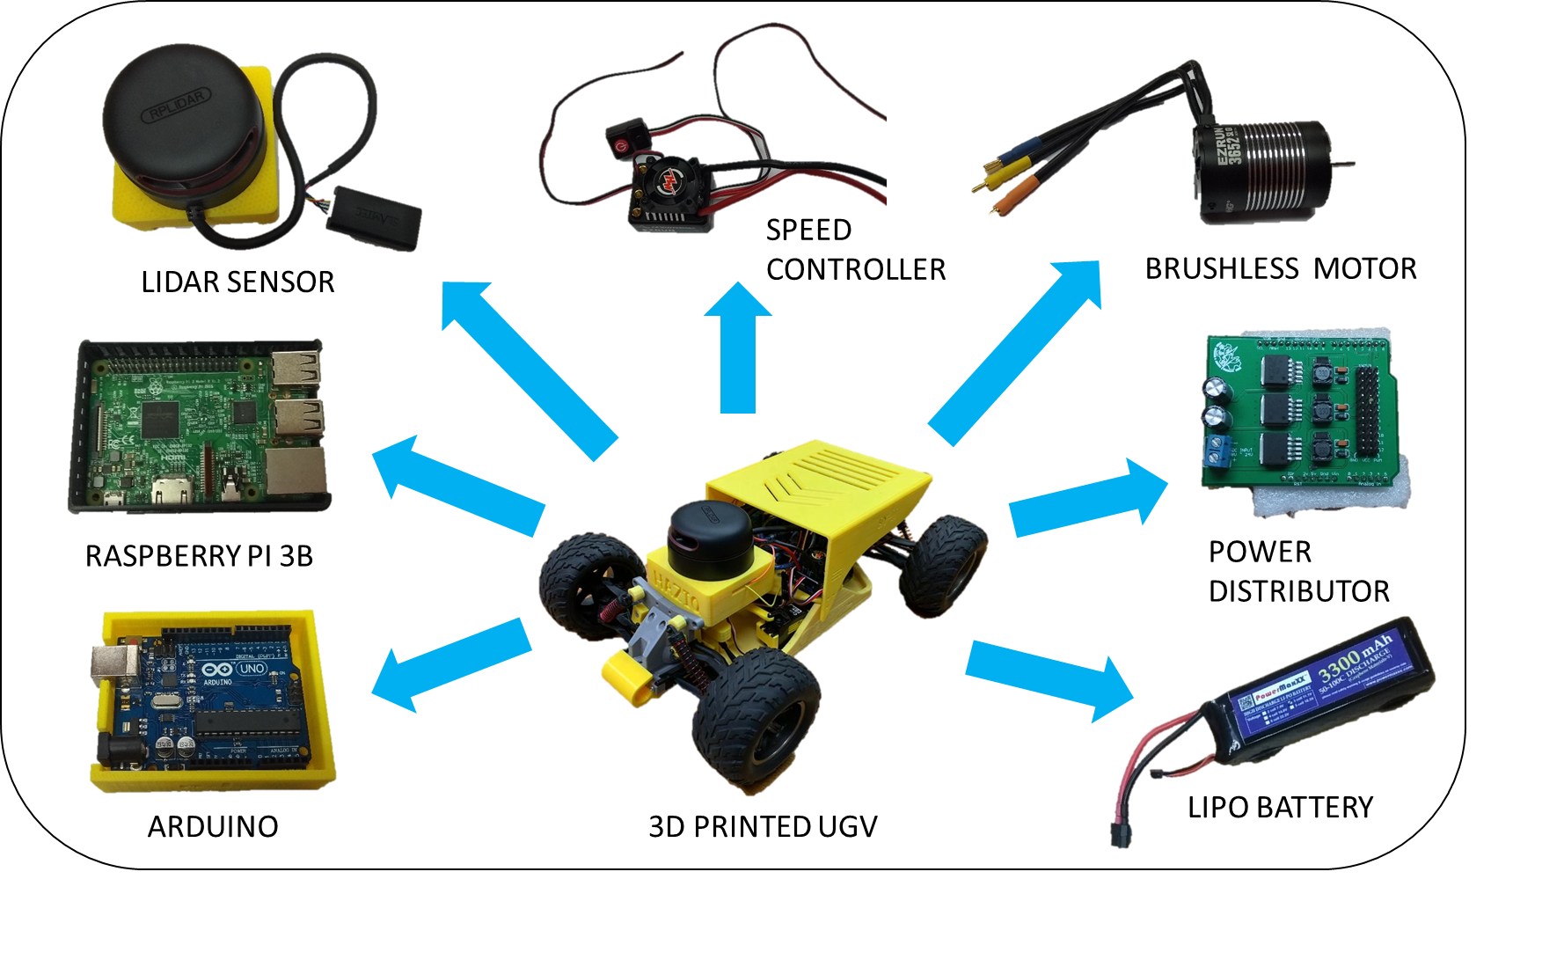
UGV Setup
Design optimization

Slide 12
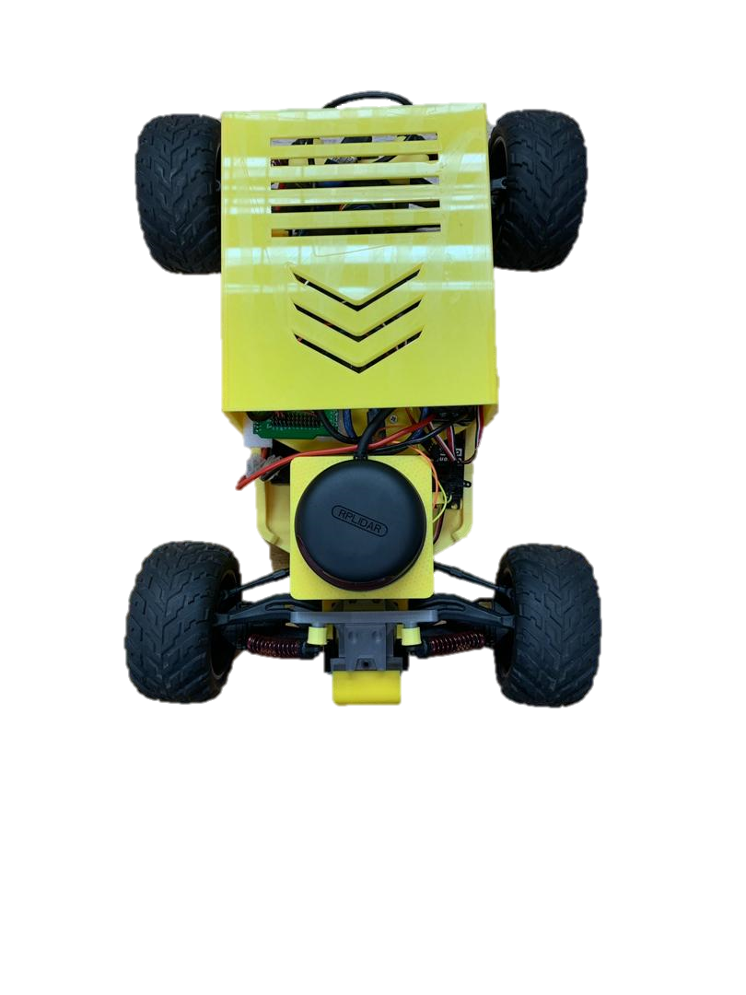
UGV Setup
35 degree to 55 degree range
90 degree
Obstacle
350 degree to 10 degree range
0 degree
270 degree
305 degree to 325 degree range

Slide 13

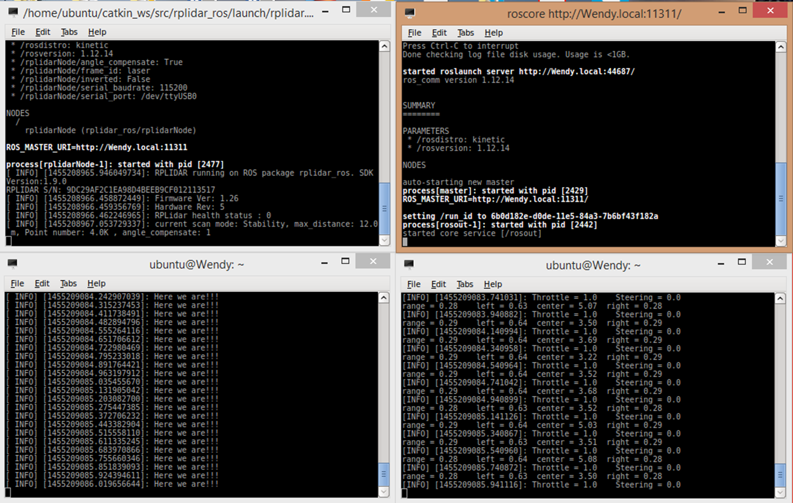

Work flow in the programming system
ALL ABOUT TECHNOLOGY

Slide 14

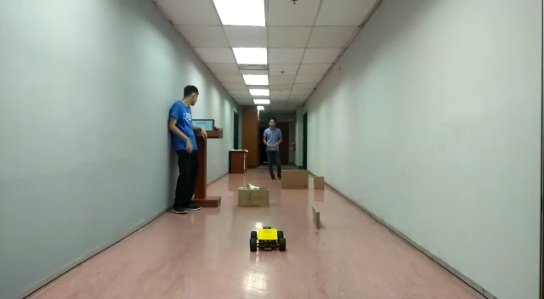
1st Test running the UGV

Slide 15
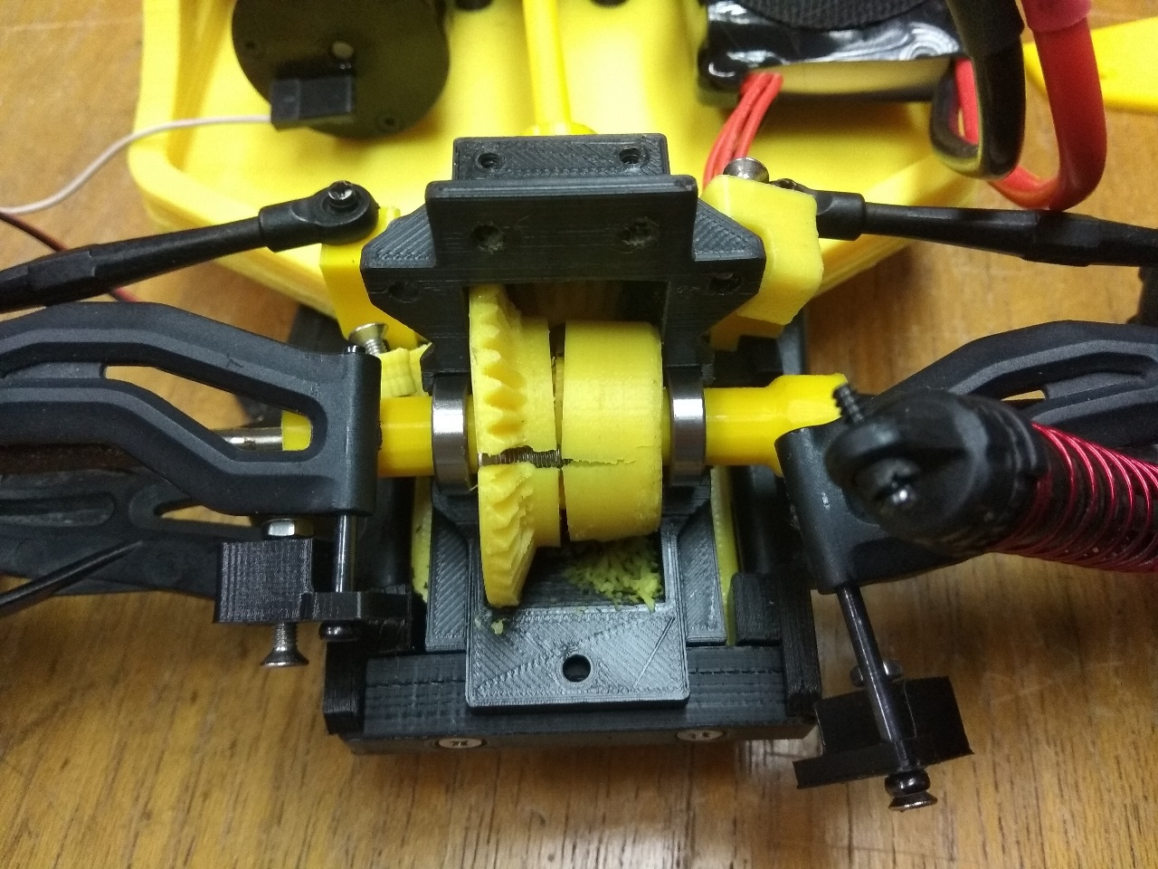
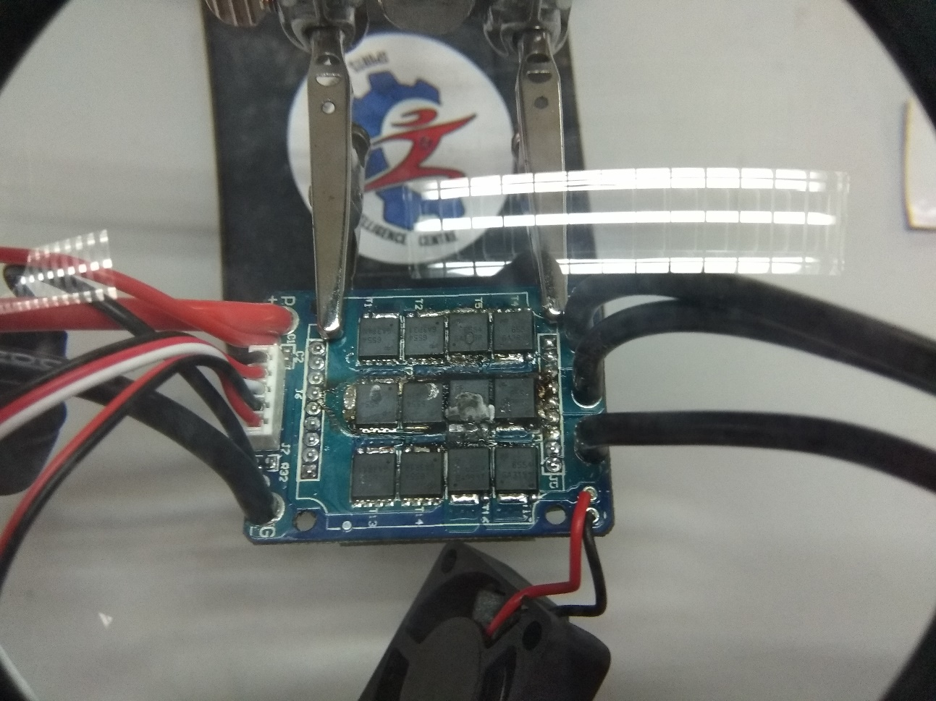
1st Test RESULT
3D printed gear has been worn out
ESC burn out because of high current

Slide 16
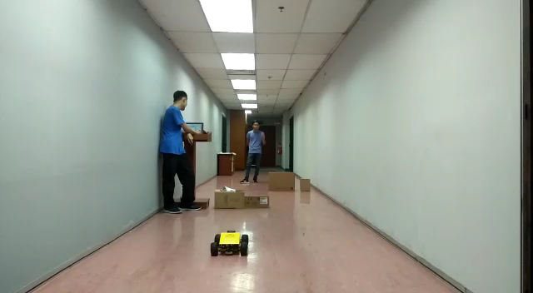
2nd Test running the UGV

Slide 17

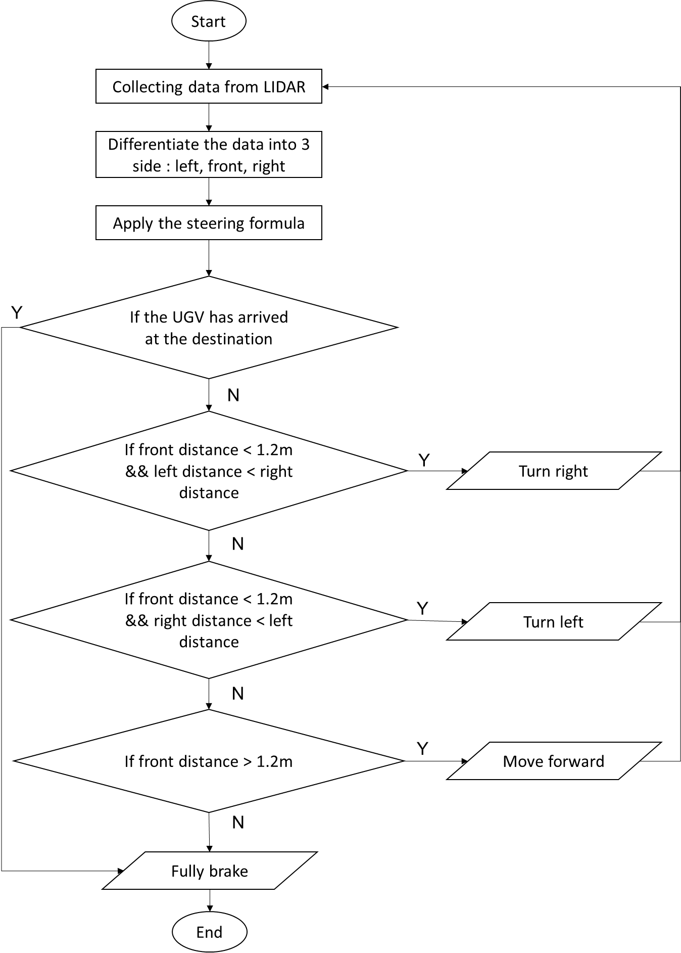







FINAL YEAR PROJECT 2018
UiTM
IMPROVEMENT
Sensing & Actuation (SENACT)
Hardware and software integrating.
Programming Platforms
A common platforms will be C++, JAVA, Arduino, and Phyton.
Better Design
Chassis mounting design for brushless motor and SENACT housing design.

Slide 18
THANK YOU

